Slide 1
Magnetic recording Code
Reading process must sample the surface at a known rate
Two important facts
  Moving speed of surface
  Cell density(number of cells per inch)
If timing circuit runs too fast and surface speed is too slow
  Cells may be sampled twice
If surface moves at a rate in advance of the sampling rate
  Cells may be missed

Slide 2
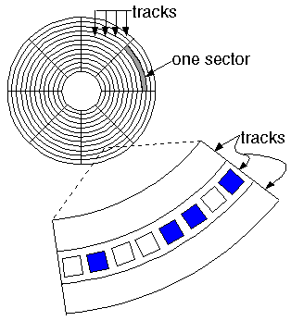
Magnetic Disc Formatting

Slide 3
Solution:
Take the timing not just from internal electronic circuitry but from the surface itself
sampling rate is generated as before but need to resynchronize the clock
thus data can be read correctly , even though there is a large discrepancy between surface speed and expected sample rate

Slide 4




Disk :
Timing circuit :
Head (Read) :
After Resynchronized:
Disk :
Timing circuit :
Head (Read) :
1 | 1 | 1

Slide 5
Two approaches can be can be employed to deal with this problem
  Encoding
  Servo track

Slide 6
Drawbacks of servo track
Extra track
Extra head
Which makes it expensive
3. Complexity
4. Storage wastage

Slide 7
Recording Codes
NRZ (Non Return to Zero)
NRZI (Non Return to Zero invert)
PE (Phase Encoding)
FM (Frequency Modulation)
MFM (Modified Frequency Modulation)
RLL ( Run Length Limited)

Slide 8
Coding
NRZ: Non returning 0
NRZI: 0 invert : 2nd 1 will be 0
PE :Phase Encoding : Halfway->flux reverse
FM: Frequency Moduling: for 0->1; 1->flux reverse
MFM: Modified FM
RLL: Run Length Limited

Slide 9
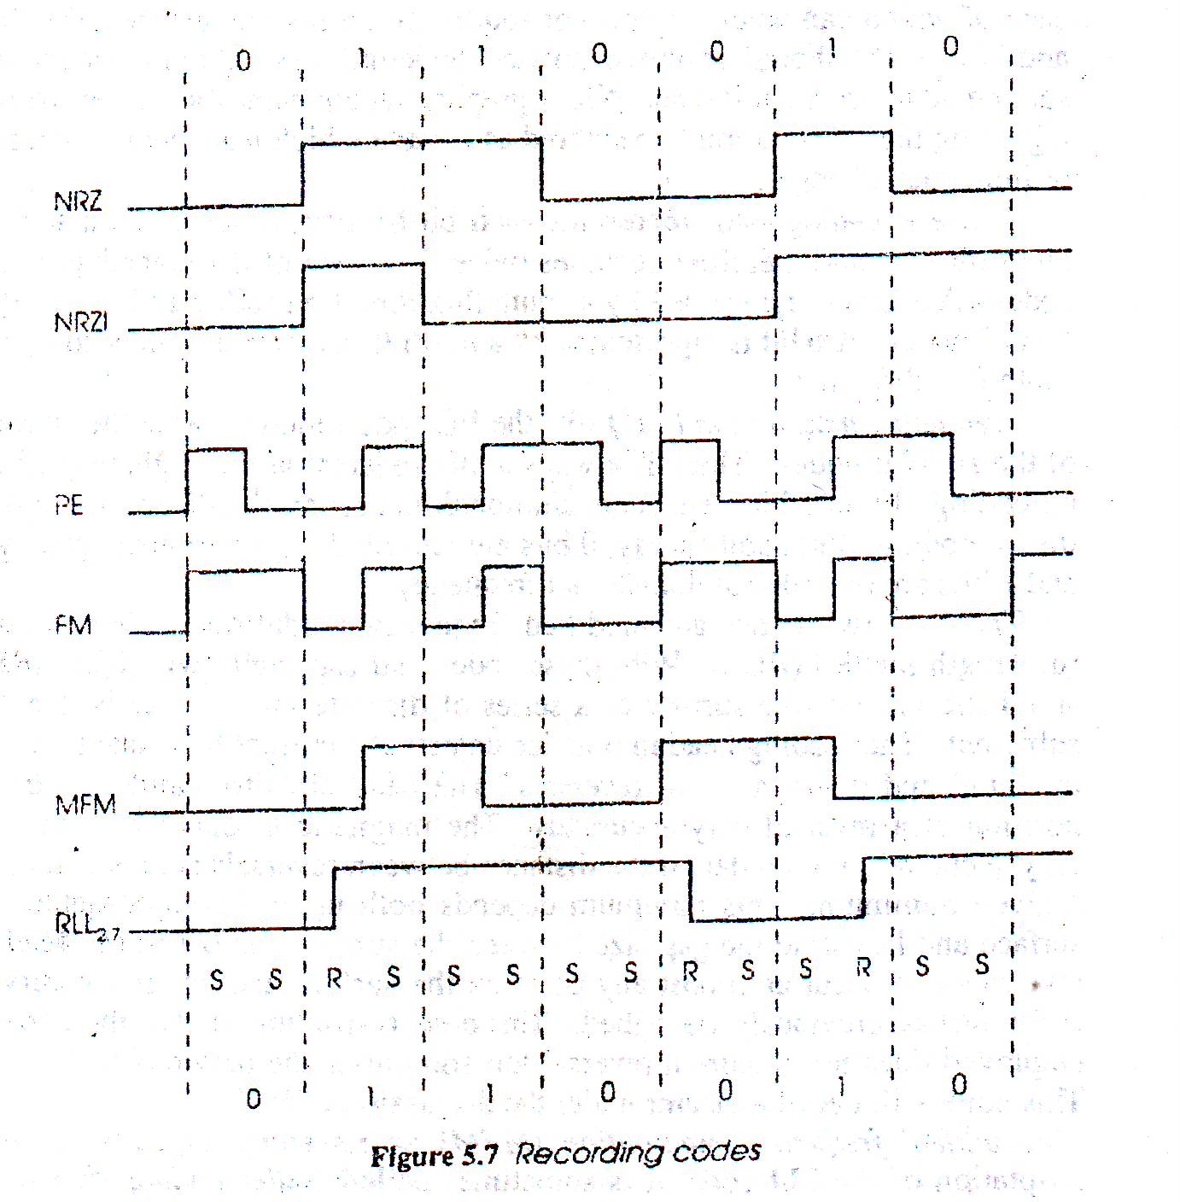

Slide 10
Run- Length- Limited (RLL)
Specify a minimum and maximum distance between flux reversal
A binary code in which a 1 is inserted after a certain number of 0's, in order to avoid long strings of 0's, which would require very accurate clocking in order to ensure that a bit was not lost. Abbreviated as RLL code.
The word "run" here refers to a sequence of spaces in the output data stream without flux reversals

Slide 11
  The two parameters that define RLL are the run length and the run limit (and hence the name)
  run length : the minimum spacing between flux reversals
  run limit : the maximum spacing between flux reversals
The particular variety of RLL used on a drive is expressed as "RLL (X,Y)" or "X,Y RLL" where X is the run length and Y is the run limit
For example : RLL_{2,7} RLL_{1,7}
Each S/R code is one third of the length of magnetic cell
  Three S/R codes can occupy the space of one cell
  Magnetic cell can hold one and half data bits
  Thus RLL_{2,7} can store 50% more data than NRZ, NRZI or MFM

Slide 12
Bit Pattern | Encoding Pattern | Flux Reversals Per Bit | Bit Pattern Commonality in Random Bit Stream
11 | RNNN | 1/2 | 25%
10 | NRNN | 1/2 | 25%
011 | NNRNNN | 1/3 | 12.5%
010 | RNNRNN | 2/3 | 12.5%
000 | NNNRNN | 1/3 | 12.5%
0010 | NNRNNRNN | 2/4 | 6.25%
0011 | NNNNRNNN | 1/4 | 6.25%
  Value of minimum and maximum run length?
  Average flux reversal/bit?

Slide 13
Optical Storage
Retains its information when power is removed
Codes data as variations on an optical surface
Variations affect
  How light is reflected
Surface perfectly reflects
  When variations (bumps and pits) are not present
Amount of light directly reflected from bumps and pits are less than that reflected from smooth surface
  Gives means of binary storage

Slide 14
Advantage:
laser beams can be focused to detect variations which are extremely tightly packed
  Thus for same surface area optical storage can give much higher capacity than magnetic storage
Disadvantage:
  Optical storage systems are not re-writable
  Data transfer rate is slower

Slide 15
Forms of Optical Disc storage
Three common forms-
  Compact Disc Read-Only Memory (CD-ROM)
  Write Once Read Many (WORM)
  Magneto- Optical disc (MO)

